Slide 1
Choosing a GYM in Taipei

Slide 2
Introduction
the trend of working out is increasing in Taiwan, people find gyms more important than ever
show gyms across Taipei
helps people to choose their gyms depending on the district
focus primarily on the distance aspect instead of ratings
One of the largest reasons is that people are lazy, so choosing a closer gym makes a person more willing to work out each day.
The result from this project is going to display most gyms in Taipei city
From the result, people can easily see how many gyms are located near their home, and which one is the nearest.

Slide 3
Data
These are the data involved in this project:
Coordinates of each districts in Taipei City
From Wikipedia
Manually organized them into a excel spreadsheet
Foursquare API to locate the gyms in Taipei
Coordinates of each gym
Names of each gym
Display the gyms on a map using folium

Slide 4
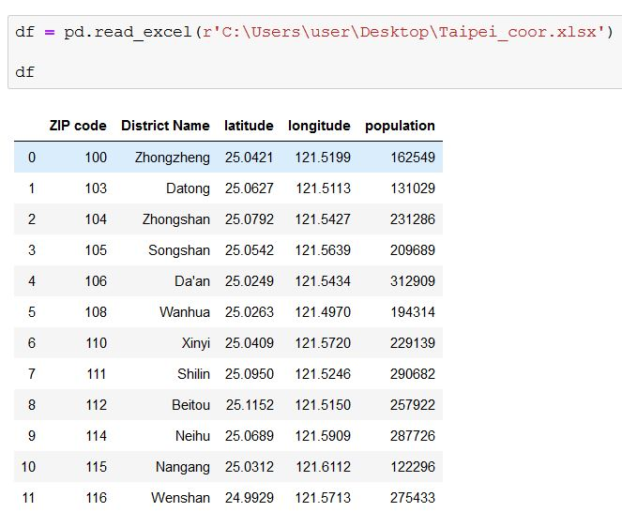
original excel spreadsheet as a dataframe

Slide 5
Methodology

Slide 6
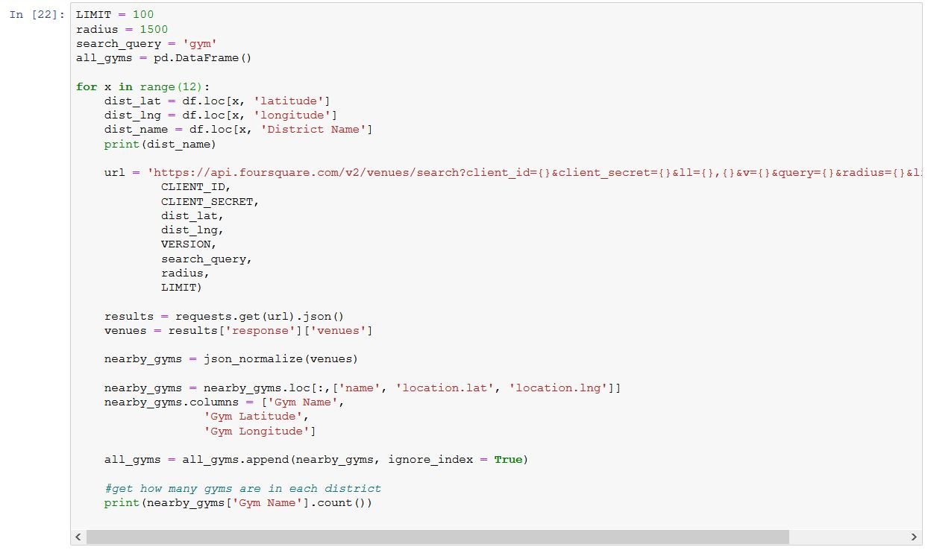
Get the location of Gyms using for loop
To retrieve the gym locations in each district using the Foursquare API, I built a for loop that calls the Foursquare API once using each district's coordinates

Slide 7
Get the location of Gyms using for loop
As you can see, by setting the search query to "gym", the Foursquare API only retrieves relevant locations

Slide 8
Get the location of Gyms using for loop
After the url is generated, I filter out only the relevant information such as names and coordinates of each gym.
I retrieve the number of gyms in each district, so that I could better understand the scenario in each district.

Slide 9
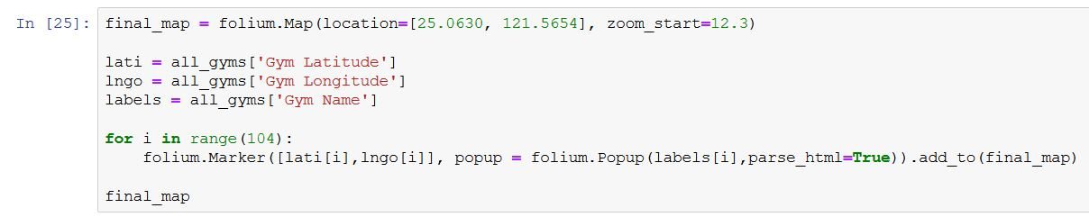
Maps out all the Gyms
After getting the location of gyms in Taipei, I then use folium to map out and label all of them.
I set the starting location to be the center of Taipei City, and I use another for loop to label each gym.

Slide 10
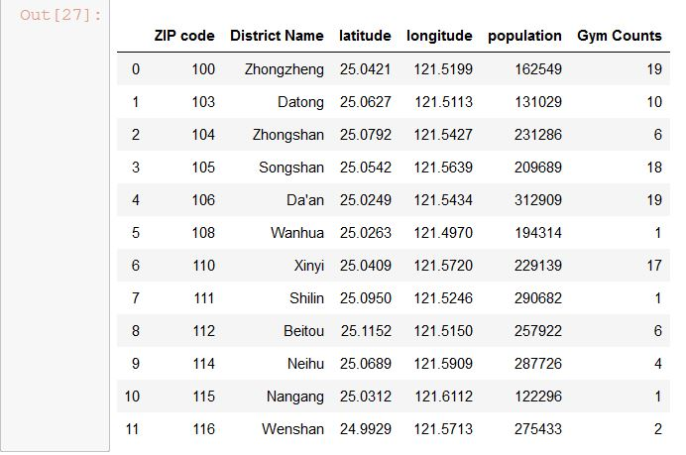
How many gyms are in each District?
From the output above, we now know how many gyms are in each district given a certain range. We then add a column to the original df dataframe to show the number of gyms in each district.

Slide 11
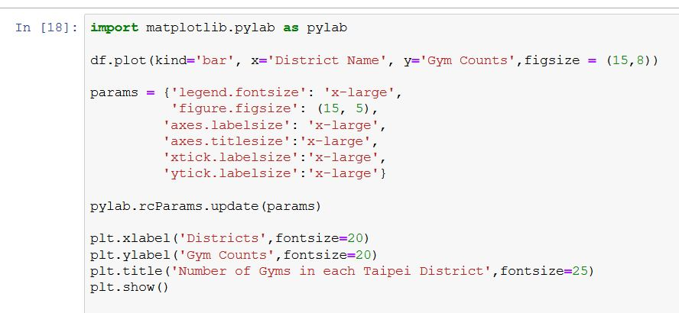
Visualize the Data

Slide 12
Results

Slide 13
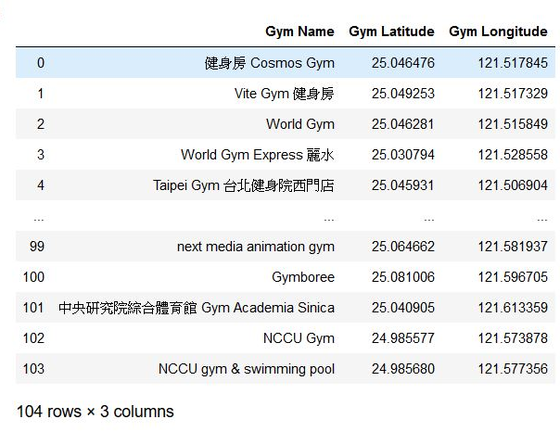
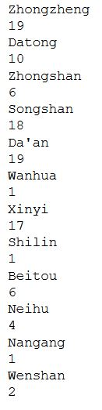
From the for loop, I generated a dataframe that consists of the gym locations and the number of gyms in each district.

Slide 14
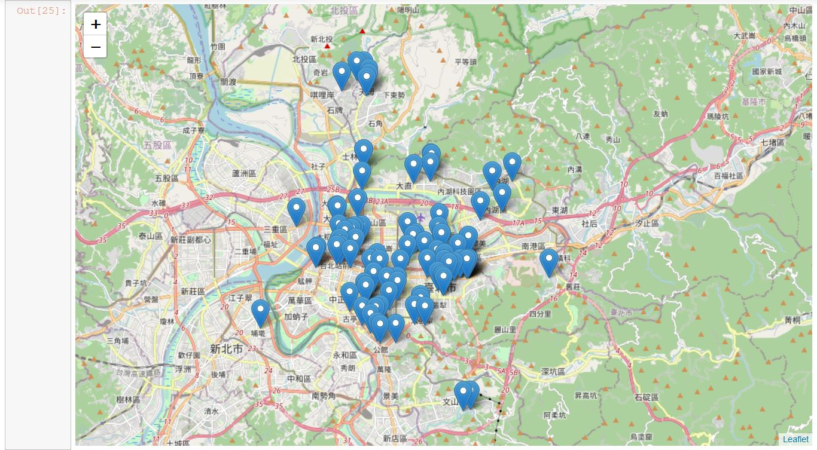
Folium map of all the gyms

Slide 15
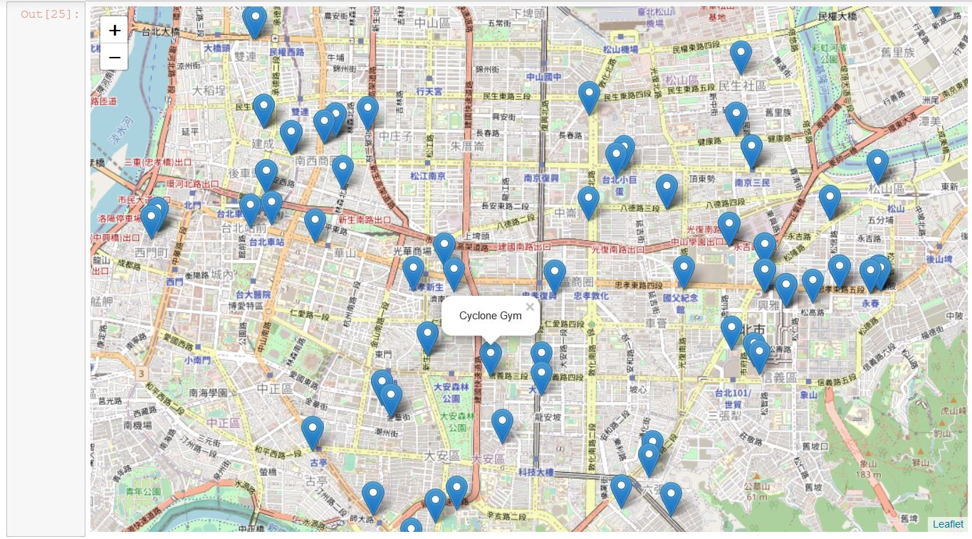
The map is interactive. So you can zoom into where you like and click on a label to see the name of that gym.

Slide 16
Using the results from the for loop above, we then add a column to display number of gyms in each district

Slide 17
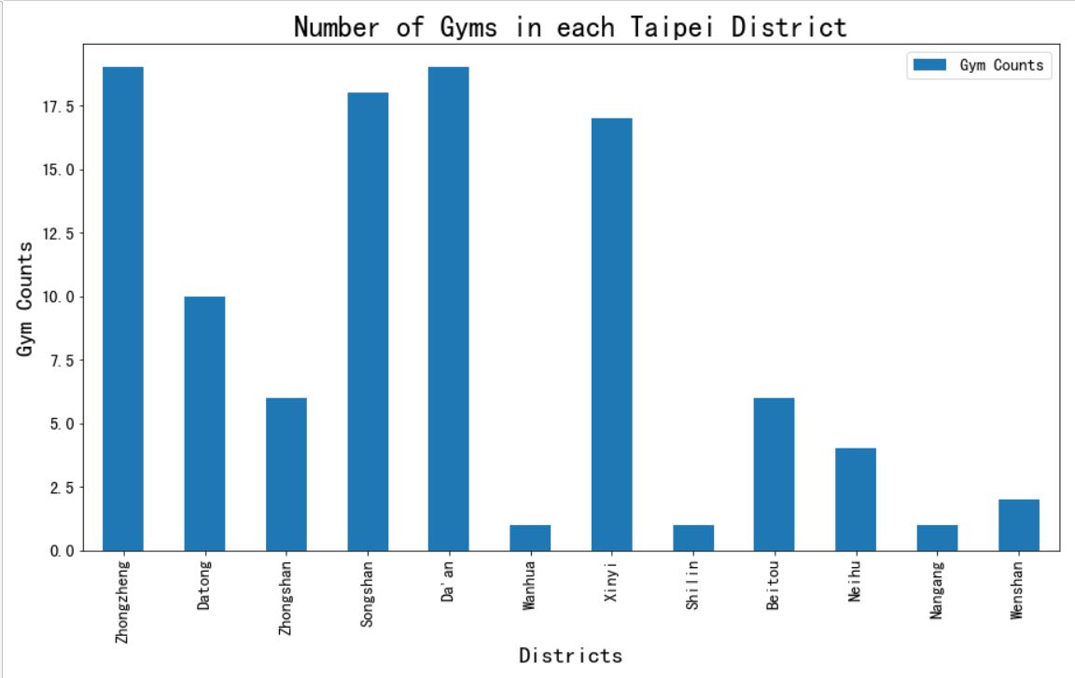
visualize the numbers

Slide 18
Discussion
Given the number of Foursquare API calls we can do per day, I have decided to retrieve only the gyms within the 1.5km radius from the district center. The main point here is to help weight-lifters to find the closest gym possible.
Here, I assume people are living / going to live at the district center and provides a wide variety of options within a 10-15min walk.

Slide 19
Discussion Cont’d
Looking at the graphs and tables above, there is one clear conclusion we could draw:
With one of the fewest population, Zhongzheng district has one of the highest number of gyms within the range. It means that fewer people are going to each gym, which may increase the quality of your work out.
Therefore, for people looking to move to Taipei, Zhongzheng district is a great choice if you lift weights often.

Slide 20
Conclusion
In this report, I've gathered information regarding coordinates of Taipei's districts and used the Foursquare API to retrieve a certain category of locations. I have further discovered that Zhongzheng district is one of the best places in Taipei when you want to work out. For people living in Taipei, regardless which district they are living in, I have suggested gyms within a 10-15minute walk. They could find the closest gym from the list. On the other hand, for gym-goers who are looking to move to this city in the future, I have generated a list of gyms for them to make their own decisions.

